Slide 1
It’s About Time Jeff Jacobson, Fairbanks City Public Works Department November 2022

Slide 2
Keeping Motorists and Pedestrians Safe Is Our Highest Priority

Slide 3
The success of keeping streets and sidewalks plowed, cleared and safe is dependent on working together to predict, plan and prepare for the unexpected.

Slide 4
Predicting Weather Conditions and Resources Needed
WEATHER MONITORING
The Streets supervisor will use the National Weather Service daily forecasts to monitor weather conditions. The Street supervisor is responsible for scheduling the snow crews’ actions based on these forecasts.
START OF SNOW AND ICE OPERATIONS
The start of snow and ice operations is determined by the actual snow fall depth of 3 inches, or less than 3 inches if combined with freezing rain or icy road conditions.
More than 3 inches of snow fall depth with no forecasted above freezing temperatures will be plowed to the edges or curbs of roads and scheduled for collection and hauled away to a snow storage site.
After the priority routes are plowed, equipment will then be dispatched to the neighborhoods to smooth up streets (3-6 days of plowing) and to start or continue snow collection in the neighborhoods.
The downtown core area will only have snow removal done by a night crew. In a typical winter, snow will be removed from the downtown core area 3 to 5 times.

Slide 5
Snow Removal History 2016-2022 11/23/2021 to 4/27/2022 35,854 Truckloads* 677,118 cubic yards November 1 thru December 31, 2021 66.2 inches of snow fell January 1-March 15, 2022 27.3 inches of snow fell November 1, 2021 thru March 15, 2022 93.5 inches of snow fell 11/5/2020 t0 4/12/2021 30,292 Truckloads* 533,995 cubic yards 11/12/2019 to 4/12/2020 25,372 Truckloads* 465,193 cubic yards 11/19/2018 to 3/25/2019 16,191 Truckloads 283,448 cubic yards 11/26/2017 to 4/5/2018 27,477 Truckloads 527,000 cubic yards 12/5/2016 to 4/3/2017 22,249 Truckloads 389,389 cubic yards * rented side dump trucks

Slide 6
Snow Removal Fleet Equipment
Public Works deploys a variety of equipment to plow and pickup snow
Eight (8) motor graders
Fifteen (15) dump trucks (one of which can double as a sander when the box is swapped out)
Two (2) tractors with side dumps
Eight (8) snow loaders/blowers
Five (5) front-end loaders (one of which can be equipped with a plow)
Three (3) sand trucks
Three (3) skid steers (these can be fitted with snowplows and snow blowers)
Three (3) holders (these can be fitted with snowplows or 1 with a snow blower)
One (1) Trackless sidewalk tractor
One (1) backhoe
Two (2) snowrators
One (1) small tractor (this can be fitted with a snowplow)
Ten (10) manual walk behind snowblowers

Slide 7
Investing in New Equipment

Slide 8
New Loaders and Attachments

Slide 9
6-wheel Drive Grader Gated Grader Blade

Slide 10
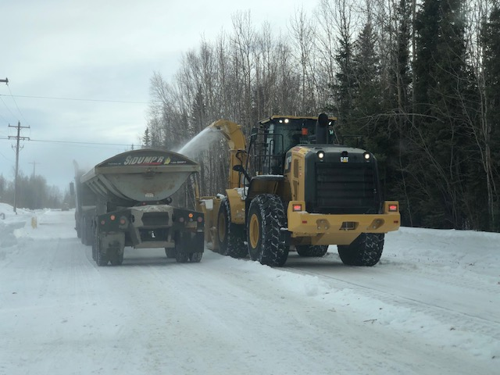
Side Dumps and Tractors can haul 2-3 times more snow than one end dump
Side Dump with raised Sideboard
Side Dump without Raised Sideboard

Slide 11
Two New Snowrators

Slide 12
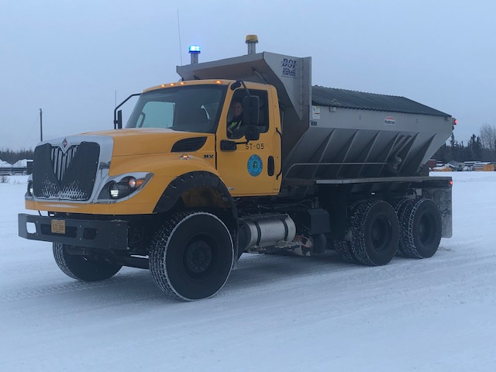
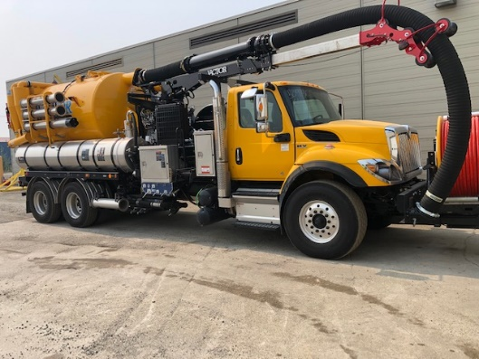
New Sander New Jet/Vac Truck

Slide 13
Street Sweeper Sidewalk Trackless Tractor

Slide 14
Efficiency of Operations
In 2020, 2021 and Spring 2022 Public Works incorporated renting side dumps for snow removal to improve efficiencies. Snow plowing and removal has gradually been streamlined for the last two snow removal seasons. Starting this snow season 2022/2023, Public Works now owns two side dumps and tractors to use throughout the season.
To provide consistency of service and retention of temp operators, the night shift is now hired for longer periods of time as needed to remove the accumulation of snow throughout the winter in the downtown core and major traffic corridors. The number of night operators fluctuates according to workload and availability of temporary operators.
Beginning in 2017, snow storage sites have been expanded (Blue Line, Bentley, South Cushman or acquired (Lazelle Street and 30th Avenue) to reduce hauling times and costs. The Lazelle snow storage site was fully operational last winter, shortening the time it takes to remove snow in Shannon Park subdivision. Public Works has an agreement in place with the Tanana Valley Fair to lease a new snow storage site for the Aurora and Johnston Subdivisions snow removal operations in order to reduce hauling times and costs from those areas.
In addition to new equipment, what is needed is more skilled labor. Eighty Percent ( 80%) of permanent staff have less than 4 years of experience. During peak winter season work longevity for temp and perm employees with less than 4 years of experience is over 90%.

Slide 15
Snow Storage Sites 2022-2023
The City has the following snow storage sites:
Blue Line/1St Avenue- Expanded in 2016
Arctic Park Lathrop Street and East Cowles- Expanded in 2017
Hamilton Acres -Request to expand site denied by FNSB Planning Commission 2017
South Cushman 25th Avenue doubled in size 2019
Bentley Commercial Site doubled in size 2018
Public Works Facility 2121 Peger Road
DOT Johansen (shared with City)
Lazelle Street site operational 2021
Tanana Valley Fairgrounds MOU January-December 2022 (for snow removed from Aurora Subdivision REDUCED HAULING TIME)
30th Avenue in development for operations 2023/24 season (driveway& partial pad constructed) Once it becomes operational it will reduce hauling time for the Peger Lakes area

Slide 16
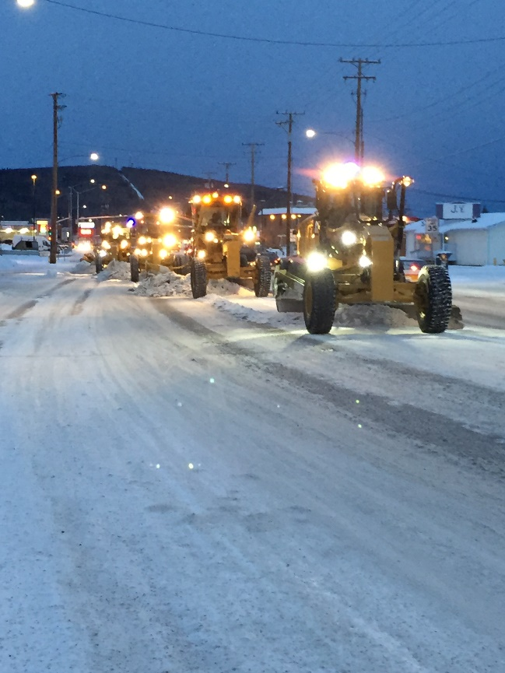
Efficiency of Operations

Slide 17
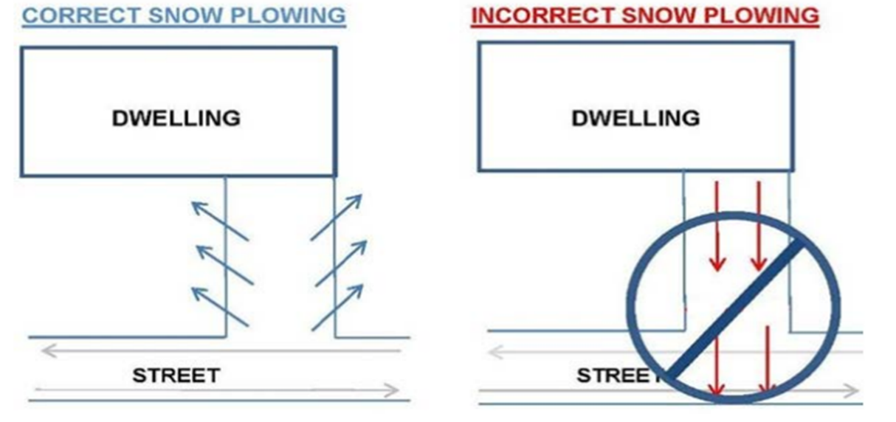
Ongoing Challenges

Slide 18
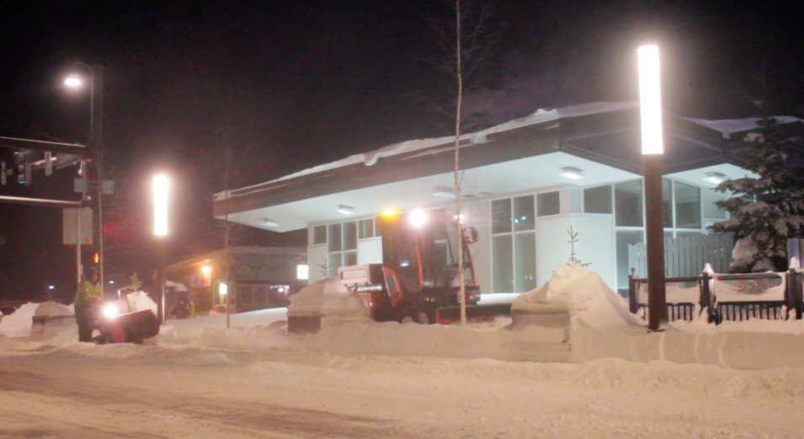

Slide 19
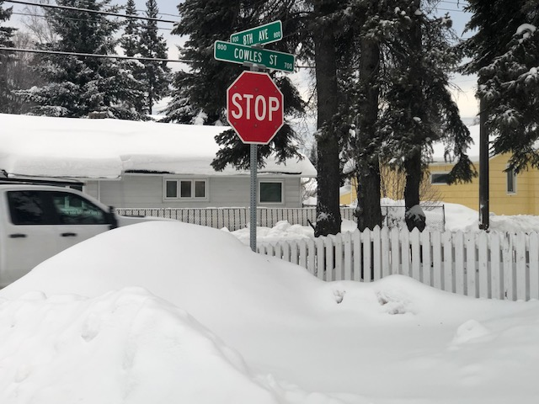
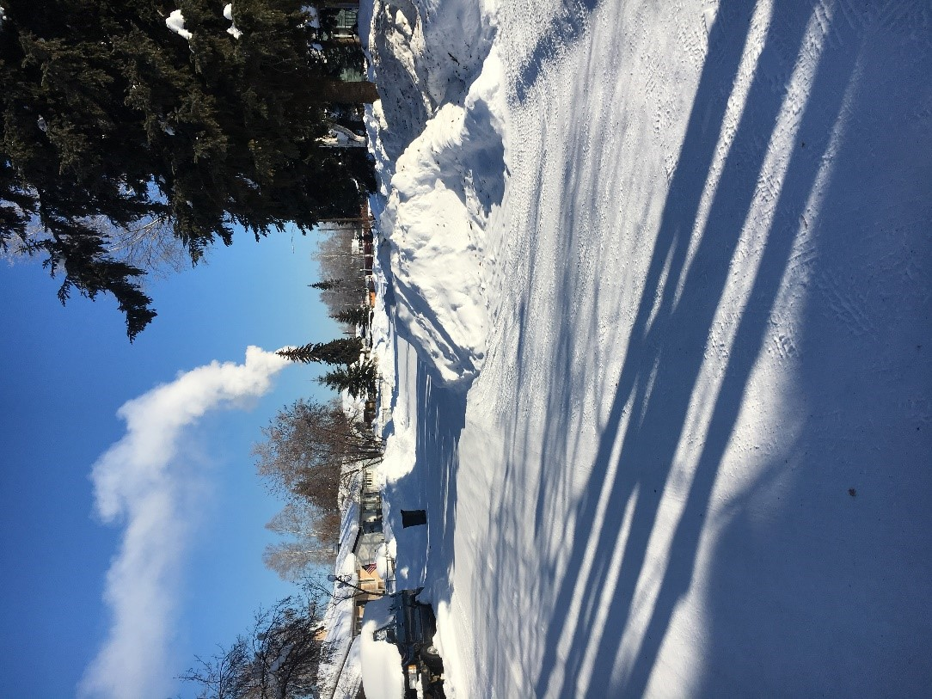

Slide 20
Doing More with Less Resources
Since 1987, the City has accepted full responsibility for many of the state-maintained streets and private developer streets within city limits:
1987 Lathrop Street,
1990 Phillips Field Road Lighting
1998 Old Steese Highway
2000 Trainor Gate Road
2000 Shoreway Drive Park-split responsibilities with FNSB Parks and Rec
2004 Aurora Drive and Wembley Avenue
2006 Hunter Street and Edmond Avenue
2007 Illinois Street
2008 Cowles Street and Sidewalks 19th -29th Avenues
2009 ADA Sidewalk Ramps 1st-12th Avenue between Cowles and Noble—(these ADA ramps must be hand shoveled)
2010 Hamilton Acres/Shannon Park- maintenance of speed humps and traffic circles,
2010 Bentley Trust Road
2010 Old Steese Highway
2012-2013 Helmericks Avenue and Herb Miller Boulevard
2013 Chena Landing Loop Street Lighting, Polaris Sculpture electricity/light bulbs and stormwater outfall, and Noyes Slough Bridge surfaces
2014 South Cushman 14th Avenue to Mitchell Expressway
2015 Bentley Retail Loop and roundabouts
2016 Aurora Drive bridge surfaces over Noyes Slough, 2016 Bjerrmark Subdivision 12 traffic circles, 23rd Avenue choker, 27th Avenue traffic diverter
2016 seasonal installation and removal of concrete planters on Cushman Street
2017 new Bjerremark sidewalks 23rd-27th Avenue, 2017 A-64 2 speed humps
2017 as part of Minnie Street reconstruction, the City will maintain the new sidewalks,
2019 new sidewalks on Cowles Street 23rd-29th Avenues
2019 new sidewalks on Gillam Way and 2 traffic circles and 1 bulb-out
2019 new 5th Avenue sidewalks Barnette Street to Cowles
2020 Wembley Avenue Fence
2022 Chena Landing Bike Path
2022 as part of new Cushman Street Bridge project, City will maintain new pedestrian sidewalk ramp access
2022 as part of the Wendell Street Bridge project, City will maintain new pedestrian sidewalk ramp access

